Slide 1
Find product assignment

Slide 2
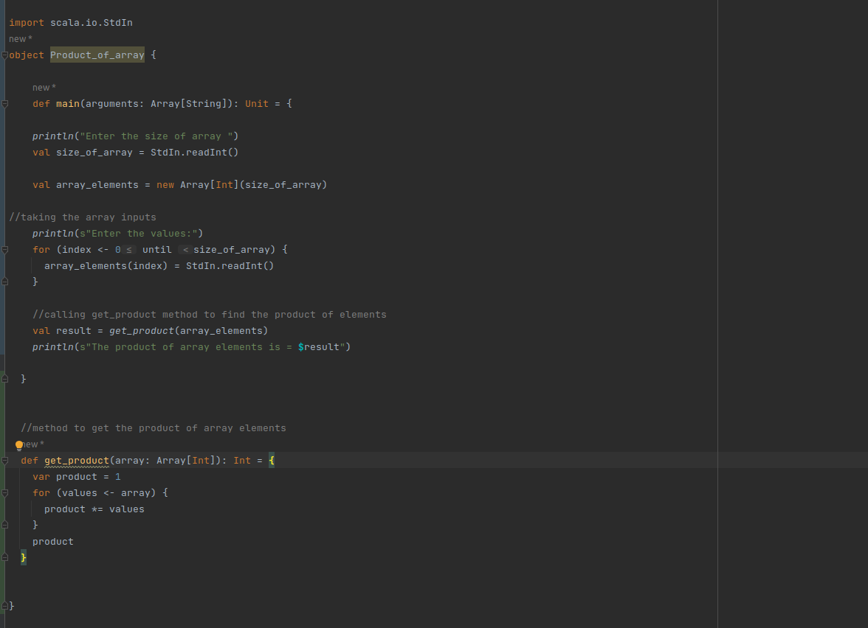
Code

Slide 3
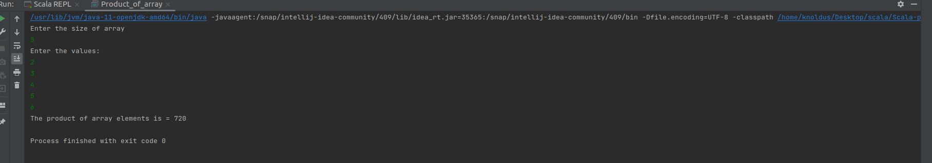
Output

Slide 4
Thank you

